Slide 1
Computer Organization and Architecture
29th Sep, 2010
Dr. Hammad Afzal
Dr: HammaD AfzaL - Computer Organization and Architecture

Slide 2
Brief outline of today’s talk
Basic Instruction Cycle (a quick recap)
Instruction Cycle State Diagram
Dr: HammaD AfzaL - Computer Organization and Architecture

Slide 3

Instruction
Program
  A sequence of steps
  For each step, an arithmetic or logical operation is done
  For each operation, a different set of control signals is needed
Instruction Cycle
  Fetch the instruction from memory
  Execute the instruction
Dr: HammaD AfzaL - Computer Organization and Architecture

Slide 4
Instruction Cycle
Fetch the instruction from the memory
Address in the Program Counter register
  Program Counter (PC) holds address of next instruction to fetch
Increment the Program Counter
  Unless told otherwise
Instruction loaded into Instruction Register (IR)
Decode the type of instruction
Fetch the operands
Execute the instruction
Store the results
Dr: HammaD AfzaL - Computer Organization and Architecture

Slide 5
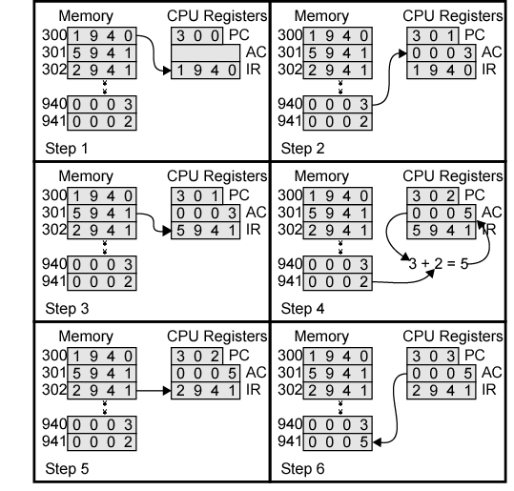
Example of Program Execution
Notes:
Give snapshots of other slides

Slide 6
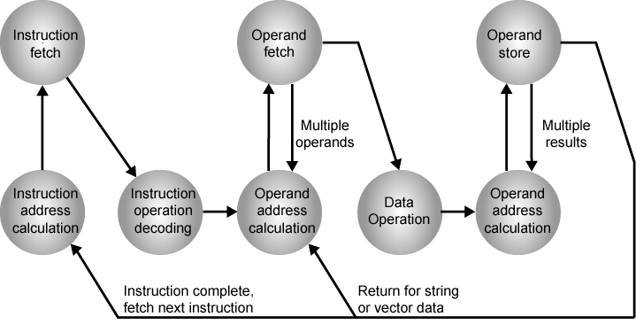
Instruction Cycle State Diagram

Slide 7
Instruction Cycle State Diagram
Self Study
Please read about the state diagram given in previous slide from book

Slide 8
THE END

